Slide 1

Unit - 4 Environmental Impact Assessment
Evolution, Concepts, Methodologies, Screening, Scoping and Checklist of EIA - Rapid and Comprehensive EIA - Legislative and environmental clearance procedure in India - Prediction tools for EIA - Assessment of Impact of air, water, soil, noise, biological and Socio cultural environment - Public participation - Resettlement and Rehabilitation - Documentation of EIA

Slide 2
Concepts of the environment:
The term “environment” is all-encompassing; it means essentially everything around us, including the conditions under which we live.
1. Bio-physical
Land, water, and air including all layers of the atmosphere,
All organic and inorganic matter and living organisms, and
Interacting natural systems (ecosystems).
2. Socio-economic and cultural
The social, economic, and cultural conditions influencing the lives of people and the communities they live in.
3. Built environment
Any building or structure made by people.

Slide 3
The World Bank (1994) defines the environment as “the natural and social conditions surrounding mankind including the future generation”.
Human society receives numerous benefits and services from the ecosystem.
Ecosystem: Provide water sources and habitats for plants and animals, and facilitate the natural recycling of wastes and flood control.
Ecosystems provide material input to the economic system, producing man-made capital and also providing ‘sink’ functions to all the wastes produced through economic activities. However, human encroachment and ever-increasing wastes have disrupted the assimilative function of ecosystems, causing the integrity of ecosystems to degrade.
1. Life-supporting functions,
2. Socio-cultural functions,
3. Productive functions, and
4. Sink functions.

Slide 4
Environmental Impact Assessment (EIA)
Evolution
EIA is a major instrument applied with the goal of making economic development projects environmentally sound and sustainable.
EIA was first used in the USA in 1970 and spread rapidly throughout the world, particularly after the UN Earth Summit in 1992.
In developing countries, EIA was initially used at the initiative of donor agencies; later, however, most national governments have realized that development-related decisions could be substantially improved by taking environmental issues into consideration before the implementation of development projects.
To enable such issues to be taken into consideration in decision-making, it was essential to introduce systematic procedure of EIA.

Slide 5
EIA is an activity designed to identify and predict the impact of a project on biogeophysico-chemical environment and on human health so as to recommend appropriate legislative measures, programs, and operational procedures to minimize the impact.
Formally EIA can be defined as “a process by which information about the environmental effects of a project is collected, both by the developer and from other sources, and taken into account by the relevant decision making body before a decision is given on whether the development should go ahead”.

Slide 6
EIA can also be defined more simply as “an assessment of the impacts of a planned activity on the environment” (UNECE 1991).
In addition to the decision on whether a project should proceed, an EIA will consider aspects such as project alternatives and mitigation measures that should be implemented if the development is allowed.
The findings of an EIA are presented in a document called an Environmental Statement or Environmental Impact Statement (EIS).
EIAs involve individual assessments of aspects of the environment (e.g. population, landscape, heritage, air, climate, soil, water, fauna, flora) likely to be significantly affected by a proposed project.

Slide 7
During the 1970s and 1980s the interest in and the awareness of environmental issues in developing countries increased significantly.
Environment must not be ignored but development must not be impeded.
In 1972, during the time of the United Nations Conference on The Human Environment, held in Stockholm – 11 countries participated. In 1981 – 106 Countries participated. In 1991 – All most many countries participated.
The required legislations and setting up of appropriate institutions were initiated mainly during the second half of the 1970s and in the 1980s. Most developing countries now require an environmental assessment of proposed development projects.
However, it should be noted that whereas countries like the Philippines required environmental impact assessments of major projects in 1977, some important industrialized countries like the Federal Republic of Germany institutionalized similar requirements only about a decade later. Many developing countries now have made EIA an integral component of the project clearance process.

Slide 8
Many Asian developing countries like China, India, Indonesia, Malaysia, Pakistan, the Philippines, South Korea, Sri Lanka and Thailand have now carried out environmental assessments of new projects for some time.
Two countries — Thailand and the Philippines — have now carried out several thousand environmental impact studies.
The application of EIA is based upon the following three core values:
1. Sustainability – the EIA process will result in environmental safeguards,
2. Integrity – the EIA process will conform to agreed-upon standards, and
3. Utility – the EIA process will provide balance and credible information for decision-making.

Slide 9
EIA Concepts
Under the three core values, the following eight guiding principles govern the entire process of EIA in its implementation:
1. Participation: all interested parties have appropriate and timely access to the process
2. Transparency: all assessment decisions and their basis are open and accessible
3. Certainty: the process and timing of the assessment are agreed upon in advanced and adhered to by all participants
4. Accountability: decision-makers are responsible to all parties for their actions and decisions under the assessment process
5. Credibility: assessment is carried out with professionalism and objectivity
6. Cost-effectiveness: the assessment process and its outcomes ensure environmental protection at the least cost to society,
7. Flexibility: the assessment process is able to adapt so that it can deal efficiently with any sort of proposal and any decision-making situation, and
8. Practicability: the information and outputs provided by the assessment process are readily usable in decision-making and planning.

Slide 10
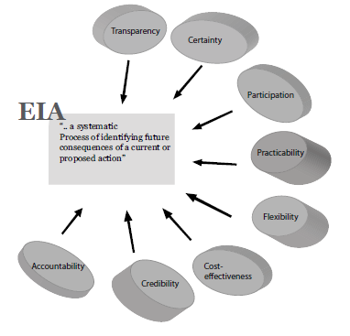
Environmental impact assessment principles and processes, Courtesy: Environmental impact assessment by Ram B. Khadka et al.,
So, EIA is a process, EIA is part of project planning, and EIA is a proactive way of addressing environmental concerns.

Slide 11
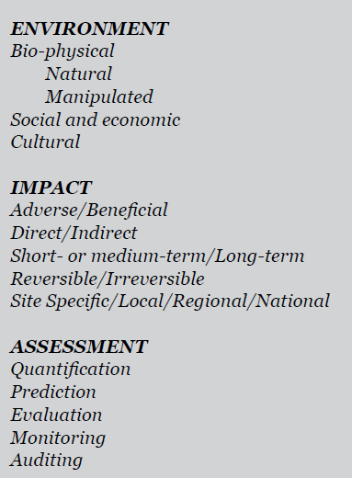
Meaning of EIA
Courtesy: Environmental impact assessment by Ram B. Khadka et al.,

Slide 12
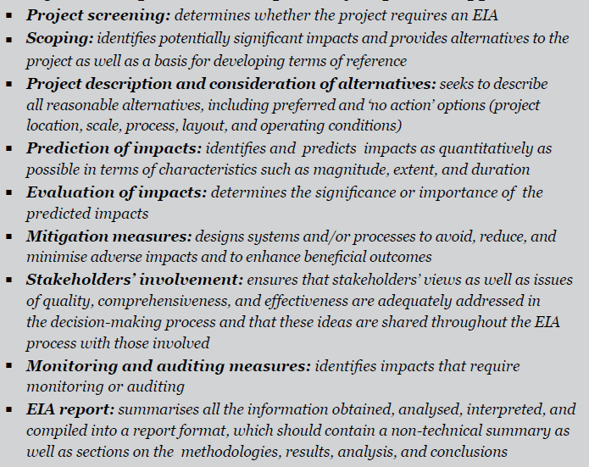
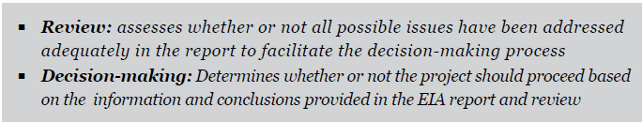
EIA Methodologies
Courtesy: Environmental impact assessment by Ram B. Khadka et al.,

Slide 13
The EIA procedure in India includes six stages:
i) Application Form 1,
ii) Screening/scoping,
iii) Preparation of Terms of Reference,
iv) Preparation of draft prior to EIA report,
v) Public consultation, and
vi) Application for Environmental Clearance Certificate.
The time it takes to get an EIA approved ranges from 30 days to 10 months from the date of submission. However, in places, the approval process takes even longer, contingent upon fulfilling the primary legal requirements.

Slide 14
Screening
Screening is the initial stage of the EIA process. In it, a decision is made on whether an EIA is required for a particular project.
Unless screening is carried out, no further action on an EIA can be taken.
Screening is usually carried out by the developer, often in conjunction with the authorizing agency.
For effective screening, the developer must be aware of EIA and its requirements and the competent authority must be able to provide advice in an informed manner, for example, threshold criteria and their application in practice.
The role of authorizing agencies or the competent authorities is often more important in screening than the developers.
Others may also be consulted at this stage but it is not common for public nonstatutory bodies or non-governmental organizations to be involved.
To make the screening decision, certain basic information about the project, such as its scale and location and the process to be involved, is required.

Slide 15
The number of projects that are being subjected to an EIA may be very large.
Screening is required to ensure that only those projects that might have a significant impact on the environment are assessed.
Projects with few or no impacts are screened out without being subjected to an assessment and there will be no associated implications of cost and time.
A specific decision on screening should be reached with reasons, and within a specified time frame, in order to make the process efficient and effective.
A list of projects/intervention/development (focusing on scale, location, and process) is useful for this process.

Slide 16
Screening process
Screening is mandatory in most of the developing countries and it calls for the authorizing agency to screen the project after the developers submit the details of the proposed project.
Some countries do not have formal procedure for screening but most other countries have a list of projects requiring EIA or IEE, and they consider each project on a case-to-case basis.
Need for screening: The screening of development proposals during the early stages of project planning accrues the following benefits:
saves money, saves time (i.e., avoids unnecessary delay), establishes the need for the project, immediately identifies the environmental issues of major concern, and determines whether an EIA study needs to be conducted.
Screening classifies project proposals into the following three categories:
1. Project clearly requiring an EIA, 2. Project not requiring an EIA, and 3. project which may or may not require an EIA and should consider conducting an IEE to see if an EIA is needed.

Slide 17
Development projects have biophysical as well as social and economic impacts.
The scale of a project is a key factor in determining whether an environmental assessment is warranted.
The scale of a project is a measure of its size, the number of people potentially affected, and the extent to which the natural systems are disrupted.
A sufficient understanding of each of these factors is necessary in order to make the initial screening decision.

Slide 18
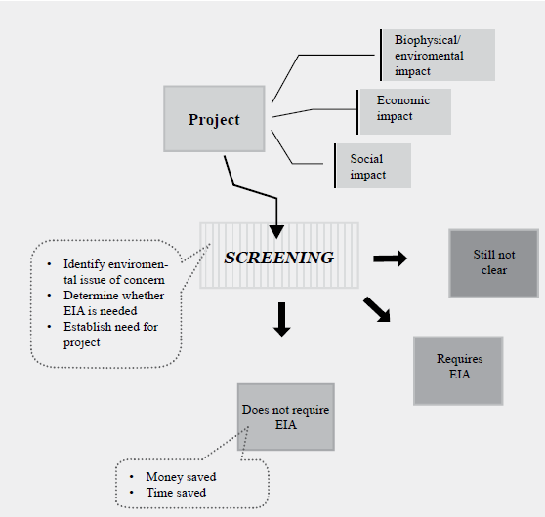
Project screening process
Courtesy: Environmental impact assessment by Ram B. Khadka et al.,

Slide 19
Screening methods
1. Lists: This may be categorized as being either (i) ‘positive 'or ‘inclusive’ projects that will always require an EIA, and ii) ‘negative’ or ‘exclusive’ projects sometimes referred to as ‘categorical exclusions’.
The weakness of lists is that individual projects of the same type can vary in size, vary in plant requirements, processes and layout and, therefore, can have different environmental effects.
2. Threshold criteria: A project that exceeds a predetermined threshold may require an EIA. Thresholds can relate to project size, capital expenditure, raw materials needed, emissions or outputs, and area of land required.
Thresholds can be confusing since a project occupying 200 ha in a critical area may give rise to more adverse impacts than a project of a similar nature occupying twice the land size in a non-critical area.

Slide 20
Thresholds for environmental parameters; if any parameter exceeds the thresholds, the project requires an EIA.
Such thresholds can range from environmental factors such as the area of agricultural land used for a development project to location, cost, outputs, and infrastructure demands to national standards for air, water, and noise.
Site thresholds and Capital investment or project cost may be used as a financial threshold
3. Project type criteria: The development projects are usually divided into broad categories, each of which reflects different degrees of potential impact on the environment.
These are often determined on the basis of past experience with the implementation of similar forms of development projects.

Slide 21
Scoping
After screening, the next important step is to determine the coverage or scope of an EIA study for a project proposal with potentially significant environmental impacts. This activity is referred to as ‘scoping’.
Scoping helps in developing and selecting alternatives to the proposed action and in identifying the issues to be considered in an EIA.
It is also used to establish Terms of Reference (ToR) for an EIA.
Scoping stage aims to highlight the need for further study of the impacts of a project and is an important part of the decision on whether the project should be authorized.
Scoping indicates in detail, the need for information in subsequent stages and can also be used to review alternative options for project setting and design.
Sets clear boundaries for assessment so that proponents are able to focus their time and resources on the most important issues. Setting limits also assists in limiting the amount of information to be gathered and analyzed to a manageable level.

Slide 22
Scoping stage can also be used to agree upon the criteria to be used in assessing the significance of impacts and eliminating those impacts which are insignificant.
The scoping stage is crucial as it aims to identify all the potential environmental impacts and then narrow them down so that the assessment focuses only on key issues (biophysical impacts or they may relate to the values, concerns and fears of the public and other groups).
Scoping Play a role in identifying impacts that may need to be monitored once the project is operational. Since the scoping output is documented, it can prove useful in checking the final EIA report.

Slide 23
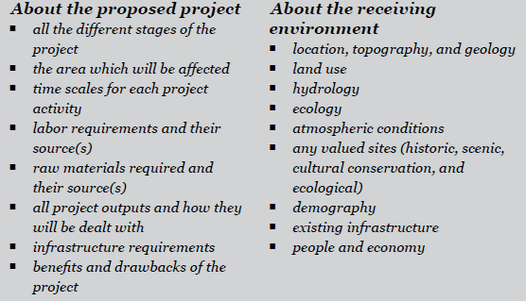
Information needed for Scoping
Courtesy: Environmental impact assessment by Ram B. Khadka et al.,

Slide 24
Aim of scoping
Identify the concerns and issues that need to be considered in an EIA.
Ensure that the EIA is relevant.
Enable those responsible for carrying out an EIA study to properly brief the study team on the alternatives and on the impacts to be considered at different levels of analysis.
Determine the assessment methods to be used.
Identify all affected interests.
Provide an opportunity for the public to be involved in determining the factors to be assessed and to secure early agreement on contentious issues.
Save time and money, and establish the ToR for the EIA study.
Scoping is not an isolated exercise. It may continue well into the project planning and design phases and even into the construction and operation phases depending on whether or not new issues arise for consideration.

Slide 25
Scoping process
Well-planned and well-structured process is needed.
In contrast to screening, scoping is very much a process rather than merely a stage and it must also consider alternatives.
The following eight objectives primarily provide a guiding principles for undertaking a scoping exercise of a project:
1. Identify all possible impacts on the environment
2. Identify all possible impacts on people
3. Inform the people in the project area who may be affected
4. Reach an appreciation of the values held by individuals and groups with regard to the quality of the environment that might be affected by the project
5. Evaluate the concerns expressed about the possible environmental impacts to determine how they should be addressed
6. Define the boundaries for any further assessment required
7. Determine the nature of any further assessment with regard to analytical methods and consultation procedures, and
8. Organize, focus, and communicate the potential impacts to all concerned.

Slide 26
Scoping requires public involvement and participation at different stages.
If scoping is not managed properly, conflict among the interest groups, such as the project proponent (who wishes to minimize time and costs), the consultant (who wishes to maximize work) and the competent authority, the consultees, and the public (who wish to gain as much information as possible), may arise.
The scoping process takes place in the early stages of a feasibility study and forms the basis for developing the ToR for an EIA.
The developer is responsible for developing scoping and ToR documents in some countries, but the approval of the authorizing agencies is required. Scoping document contain feasible alternatives, key impacts, gaps in information, and proposed further study and mitigation measures.
Elimination of issues based on the following parameters:
1. Issues that are duplicated, 2. Irrelevant issues, 3. Issues not relevant to that particular project, and
4. Issues to be addressed at the policy or strategic levels.

Slide 27
Methods of scoping
The approach to and techniques used in scoping are commonly a part of any decision-making process. Issues are identified, evaluated, and organized to be presented to decision-makers. The basic steps of a scoping exercise are:
1. Making a plan for public involvement
2. Assembling relevant existing information (preparing a public ‘information package’)
3. Distributing the information package to affected persons/public/interested groups
4. Identifying major issues of public concern,
5. Evaluating the significance of the identified issues on the basis of available information
6. Establishing priorities for an environmental assessment, and
7. Developing a strategy for addressing the established priorities

Slide 28
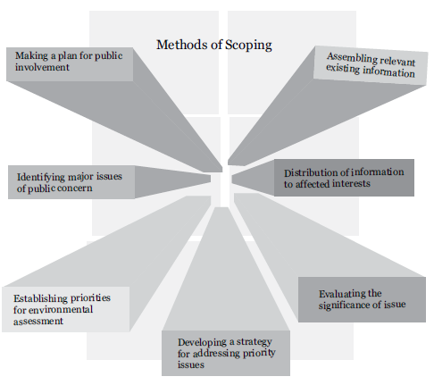
Scoping Exercise and Methods
Courtesy: Environmental impact assessment by Ram B. Khadka et al.,

Slide 29
Making a plan for public involvement
Most important internal planning tools for conducting a scoping exercise. The purpose of scoping is clearly define all the communities and agencies which are concerned with the project proposal.
Consent must be obtained from authorities and concerned government agencies. The project proponent, relevant experts, affected local people, and special interest groups should be considered for inclusion in the list of persons to be covered by the communication plan.
Methods for involving those who are affected or interested in the collection of information are:
1. inviting written submissions from relevant government agencies and the public,
2. Holding community meetings and public hearings,
3. Conducting preliminary field studies and observation of sites, and
4. Conducting workshops and seminars and establishing an inter-sector task force

Slide 30
2. Assembling relevant existing information (preparing a public ‘information package’)
This stage involves collecting information on the nature of the project and the preparation of a preliminary list of potential environmental impacts and practical alternatives.
Maps, drawings, and other aids promoting a full understanding of the project proposal are also to be collected.
All the information collected should be processed and assembled into an information package to be used to inform stakeholders about the project.

Slide 31
3. Distributing the information package to affected persons/public/interested groups
The information package should be distributed to the affected individuals and organizations, including government departments and concerned local and regional officials.
For major projects, it is always advisable to issue a general public notice inviting public comment and to hold public meetings at the project site as well as at the central level to facilitate consultation and interaction.
The project proponent is responsible for obtaining and making information available to the concerned parties.
This involves identifying all the individuals affected by the proposed project and sending information directly to local community groups.
For large projects, where all the affected individuals cannot be identified, the information should be disseminated through the media or by sending the information package to locations where interested individuals may visit.
The village communities concerned should be involved and made responsible for collecting all written or verbal responses to the project proposal.

Slide 32
4. Identifying major issues of public concern
All the concerns and issues raised by affected people should be compiled into a comprehensive list.
Each contribution should be categorized and no issue or concern, however minor or seemingly irrelevant, should be ignored or eliminated from the complete compilation.
5. Evaluating the significance of the identified issues on the basis of available information
Once the issues have been identified and grouped, their scientific validity needs to be evaluated carefully.
If certain questions of a technical nature remain unresolved, a discussion panel or workshop should be organized at an appropriate venue to resolve them.

Slide 33
6. Establishing priorities for an environmental assessment
A more detailed exercise on evaluating the significance of the issues is undertaken at this stage.
Issues which can be addressed by immediate solutions such as suggesting feasible alternatives or mitigation measures that can be implemented at an early stage and issues which have no relevance to the proposed project are dropped and the remaining key issues are arranged in order of priority.
7. Developing a strategy to address the established priorities
For those issues which need further information in order to be addressed properly, guidelines for further study will be prepared in the form of Terms of Reference (ToR).
The extent of information required for a detailed EIA depends upon the type, level, and magnitude of the project concerned.

Slide 34
Checklists of EIA
One of the first EIA methods used are the checklists which come in many different forms.
They usually consist of a list of environmental factors which may be affected by project activities and can range in complexity from simple lists of items to intricate variations which incorporate guidance on the scaling and weighting of impacts.
Various types of checklists
Simple checklist:
An easy-to-use checklist containing a list of only those environmental factors which have to be considered for EIA analysis.
Its use ensures that no factor is inadvertently omitted from the analysis
It does not provide any guidance on impact prediction.

Slide 35
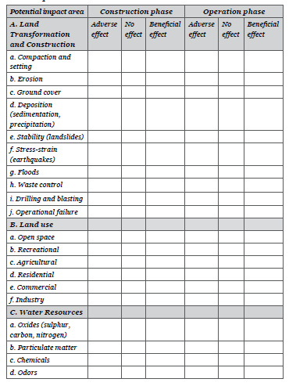
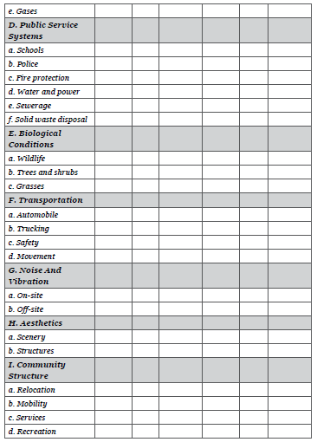
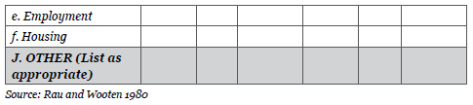
A simple project checklist organized by area of impact: An example. Courtesy: Environmental impact assessment by Ram B. Khadka et al.,

Slide 36
2. Questionnaire checklist
This method includes a a set of questions to be answered. The questions are listed under generic categories such as "terrestrial ecosystem" and "disease vectors".
Those assessing impacts must attempt to answer the questions in all categories, supplying one of three possible answers, depending on how much is known about the particular impact under consideration.
If it can be determined that an impact is likely, the response is ‘yes’; if it is unlikely, ‘no’. If there is insufficient evidence available to determine whether an impact is likely, ‘unknown’ is the appropriate response.
An ‘unknown’ response indicates that further work is needed to ascertain whether an impact is likely.

Slide 37
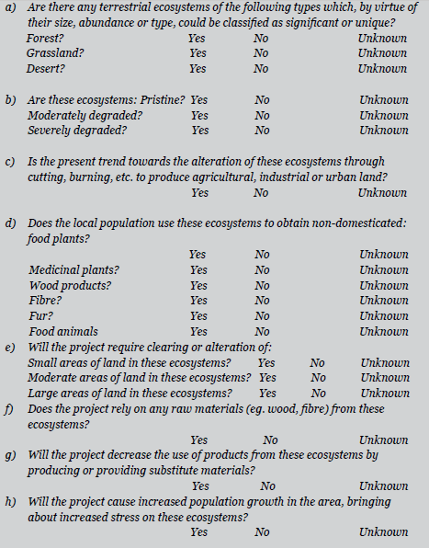
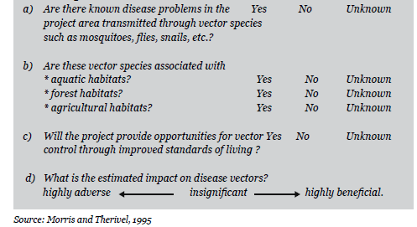
A sample questionnaire checklist for terrestrial
ecosystems:. Courtesy: Environmental impact assessment by Ram B. Khadka et al.,
A sample questionnaire checklist for disease vectors:.

Slide 38
Rapid and Comprehensive EIA
The EIA Notification 1994 categorizes EIA reports into two types based on the time-scale of the data supplied: comprehensive EIA and rapid EIA.
Rapid EIA: It is a speedier appraisal process but both types require the inclusion and coverage of all significant environmental impacts and their mitigation measures.
Rapid EIA requires that data be collected for seasons other than the monsoon. Using such a limited pool of data is acceptable as long as it does not compromise the quality of decision-making. A review of a rapid EIA will show whether or not a comprehensive EIA is warranted.
If it is felt that the project is likely to cause some detrimental effects on the environment, it is subjected to Rapid Environmental Assessment which involves:
1. Identification of the important impacts of the project on the environment.
2. Evaluation of the impact of the project on the locality or entire region.
3. Conducting cursory cast benefit analyses.
4. Listing of the issues which are unresolved and which need examination in detail.

Slide 39
Rapid Environmental Impact Assessment, thus, attempts to identify the key issues in a particular case so that attention or resources could be directed to relevant aspects.
Issues which are not important enough to deserve further studies are omitted. This helps in optimizing our resources.
Rapid Environmental Assessment usually involves interactions and discussion between public, various private organizations and experts as well as the scientific examination of impact caused by critical elements of project on the environment.

Slide 40
Comprehensive EIA
Comprehensive Environmental Assessment is usually undertaken after the initial screening and Rapid Impact Assessment has been performed.
The earlier work has already generated some information about the project and its likely impact on the environment and it is now a comprehensive study of the critical aspects of project which is taken-up in the Comprehensive Environmental Impact Assessment.
It is, therefore, clear that the submission of a professionally prepared Comprehensive EIA in the first instance would generally be the more efficient approach. It usually involves collection and evaluation of the following set of information.
Base-line data about the project, its description in detail along with the description of the existing environment.
2. Impact Identification.
Impact Prediction.

Slide 41
4. Evaluation of the impacts.
5. Mitigative measures and monitoring plans.
6. Informing the society and the decision makers.
The EIA Notification suggests that a comprehensive EIA report will normally take at least one year to complete.
Comprehensive scoping process must be completed prior to the preparation of the ToR for the EIA.

Slide 42
References
Ram B. Khadka, Steve Gorzula, Ananda R. Joshi, Shailendra Guragain, and Ajay B. Mathema. “Environmental Impact Assessment, Processes, Methods, and practices of South Asia (Bangladesh, Bhutan, India, and Nepal)”, 1 st Edition, 2013, School of Environmental Science and Management and Institute of Environment and Development: Research and Capacity Building Initiatives, Nepal.
Y. Anjaneyulu and Valli Manickam. “ Environmental Impact Assessment Methodologies, Second edition, 2007, BS Publications, India.
Peter Morris and Riki Therivel. Methods of Environmental Impact Assessment, Second edition, 2001, Spoon Press, London.
Asit K. Biswas and S. B. C. Agarwal. “ Environmental Impact Assessment for Developing Countries, 1992, Butterworth-Heinemann Ltd, Oxford.

